Slide 1

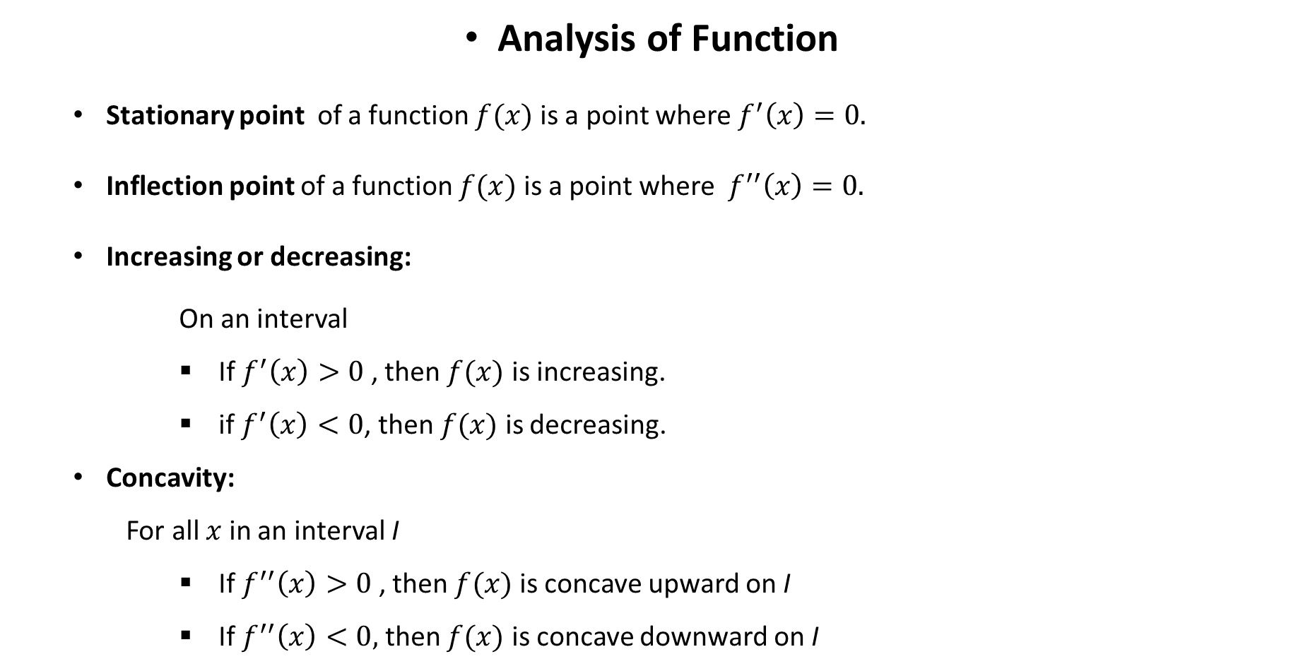


Analysis of Function
Stationary point of a function $f(x)$ is a point where $f^{′}\left(x\right)=0.$
Inflection point of a function $f(x)$ is a point where $f^{′′}\left(x\right)=0.$
Increasing or decreasing:
On an interval
If $f^{′}\left(x\right)>0$, then $f(x)$ is increasing.
if $f^{′}\left(x\right)<0$, then $f(x)$ is decreasing.
Concavity:
For all $x$ in an interval I
If $f^{′′}\left(x\right)>0$, then $f(x)$ is concave upward on I
If $f^{′′}\left(x\right)<0,$ then $f(x)$ is concave downward on I
$$f^{′}\left(x\right)=0$$
$$f^{′}\left(x\right)<0$$
$$f’(x)>0$$

Slide 2
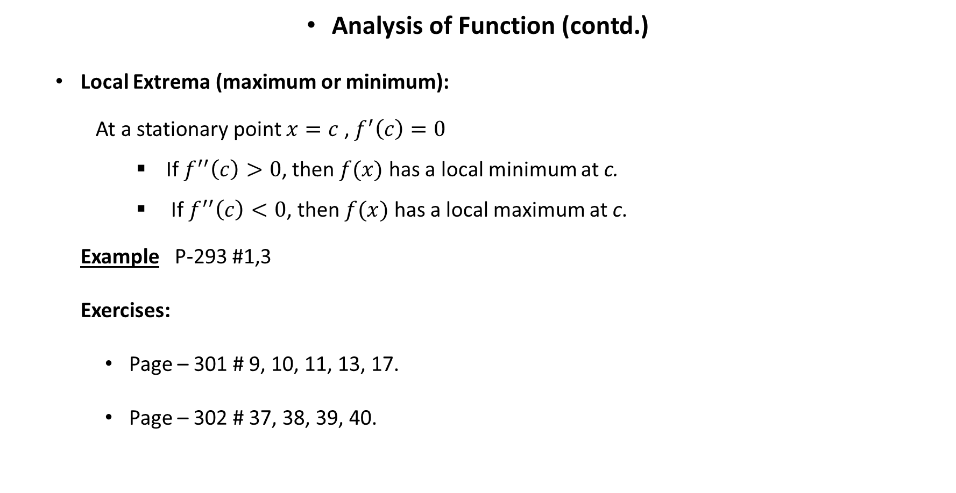
Analysis of Function (contd.)
Local Extrema (maximum or minimum):
At a stationary point $x=c$ , $f^{′}\left(c\right)=0$
If $f^{′′}\left(c\right)>0$, then $f(x)$ has a local minimum at c.
If $f^{′′}\left(c\right)<0$, then $f(x)$ has a local maximum at c.
Example P-293 #1,3
Exercises:
Page – 301 # 9, 10, 11, 13, 17.
Page – 302 # 37, 38, 39, 40.

Slide 3
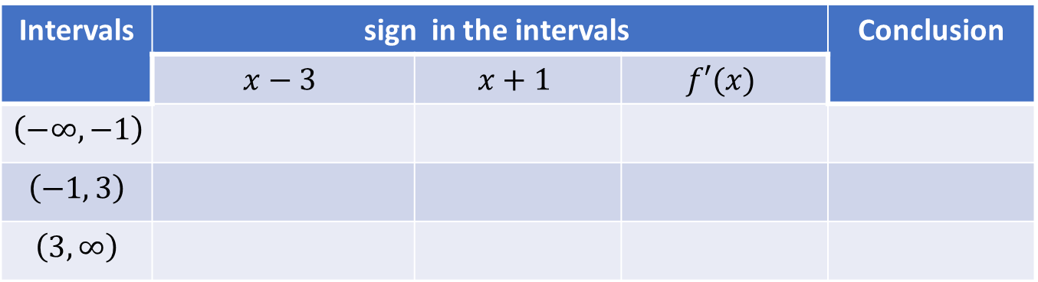




Exercise (P-301) #9 (a) Find the stationary point(s). (b)Find the intervals of increase or decrease. (c) Find the local maximum and minimum values. (d) Find the intervals of concavity and the inflection points. (e) Use the information from parts (a)–(d) to sketch the graph.
Solution
${f\left(x\right)=x}^{3}−3x^{2}−9x+4$ $f^{′}\left(x\right)=3x^{2}−6x−9=3\left(x^{2}−2x−3\right)=3(x−3)(x+1)$
(a) For stationary points $f′\left(x\right)=0$, $→ x=−1, 3$
$f\left(−1\right)=9$ and $f\left(3\right)=−23$, $∴$ stationary points are $\left(−1,9\right)$ and $\left(3,−23\right)∙$
(b)
$\left(c\right) f′′$ $\left(x\right)=6x−6$
$f′′$ $\left(−1\right)=−12,$ $∴$ $\left(−1,9\right)$ is local maximum.
$f′′$ $\left(3\right)=12,$ $∴$ $\left(3,−23\right)$ is local minimum.
$$−∞$$
-1
3
$$∞$$
Intervals | sign in the intervals |  |  | Conclusion
 | $$x−3$$ | $$x+1$$ | $$f′(x)$$
$$\left(−∞,−1\right)$$
$$\left(−1, 3\right)$$
$$\left(3, ∞\right)$$
Increasing
$$f^{′}\left(x\right)>0$$
Decreasing
$$f^{′}\left(x\right)<0$$
negative
increasing
Negative
Positive
Negative
positive
negative
decreasing
positive
positive
positive
increasing

Slide 4
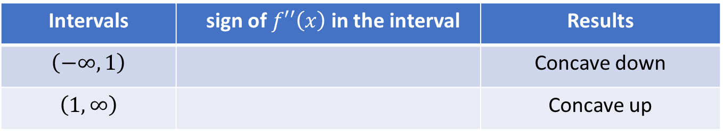

(d) For inflection points $f′′\left(x\right)=0$, $⇒6x−6=0$, $⇒x=1$
$f\left(1\right)=−7$, $∴$ inflection point is $\left(1,−7\right)$ $∙$
(e)
Intervals | sign of $f′′\left(x\right)$ in the interval | Results
$$\left(−∞,1\right)$$ |  | Concave down
$$\left(1, ∞\right)$$ |  | Concave up
negative
positive

Slide 5
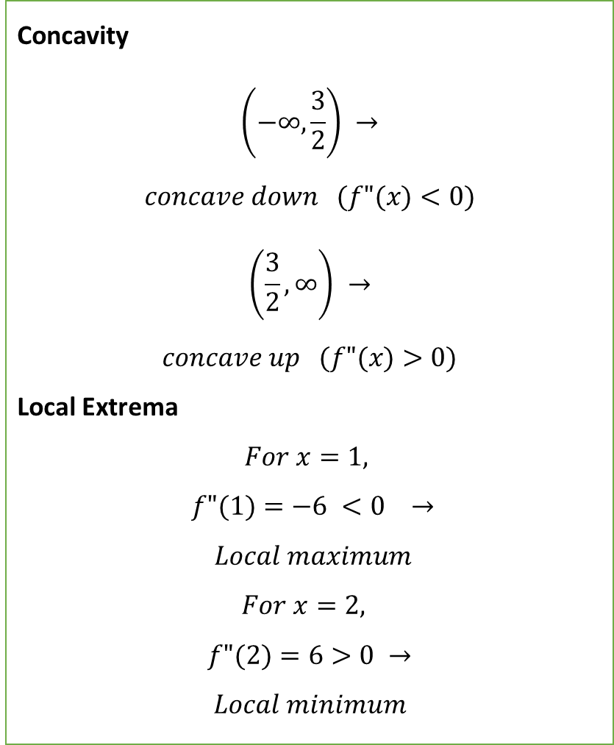
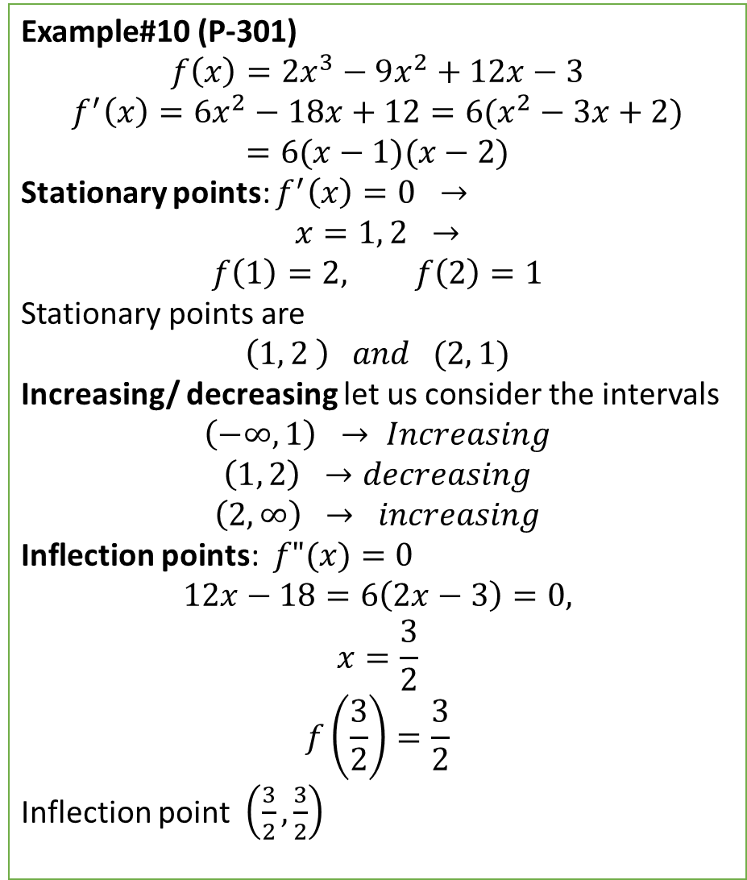
Example#10 (P-301)
$$f\left(x\right)=2x^{3}−9x^{2}+12x−3$$
$$f^{′}\left(x\right)=6x^{2}−18x+12=6(x^{2}−3x+2)$$
$$=6(x−1)(x−2)$$
Stationary points: $f^{′}\left(x\right)=0 →$
$$x=1, 2 →$$
$$f\left(1\right)=2, f\left(2\right)=1$$
Stationary points are
$$\left(1, 2 \right) and (2, 1)$$
Increasing/ decreasing let us consider the intervals
$$\left(−∞, 1\right) → Increasing$$
$$\left(1, 2\right) →decreasing$$
$$\left(2, ∞\right) → increasing$$
Inflection points: $f"(x)=0$
$$12x−18=6\left(2x−3\right)=0,$$
$$x=\frac{3}{2}$$
$$f\left(\frac{3}{2}\right)=\frac{3}{2}$$
Inflection point $\left(\frac{3}{2},\frac{3}{2}\right)$
Concavity
$$\left(−∞,\frac{3}{2}\right) →$$
$$concave down (f"(x)<0)$$
$$\left(\frac{3}{2}, ∞\right) →$$
$$concave up (f"(x)>0)$$
Local Extrema
$$For x=1,$$
$$f"(1)=−6 <0 →$$
$$Local maximum$$
$$For x=2,$$
$$f"(2)=6>0 →$$
$$Local minimum$$

Slide 6
(1, 2)
(1.5, 1.5)
(2, 1)

Slide 7
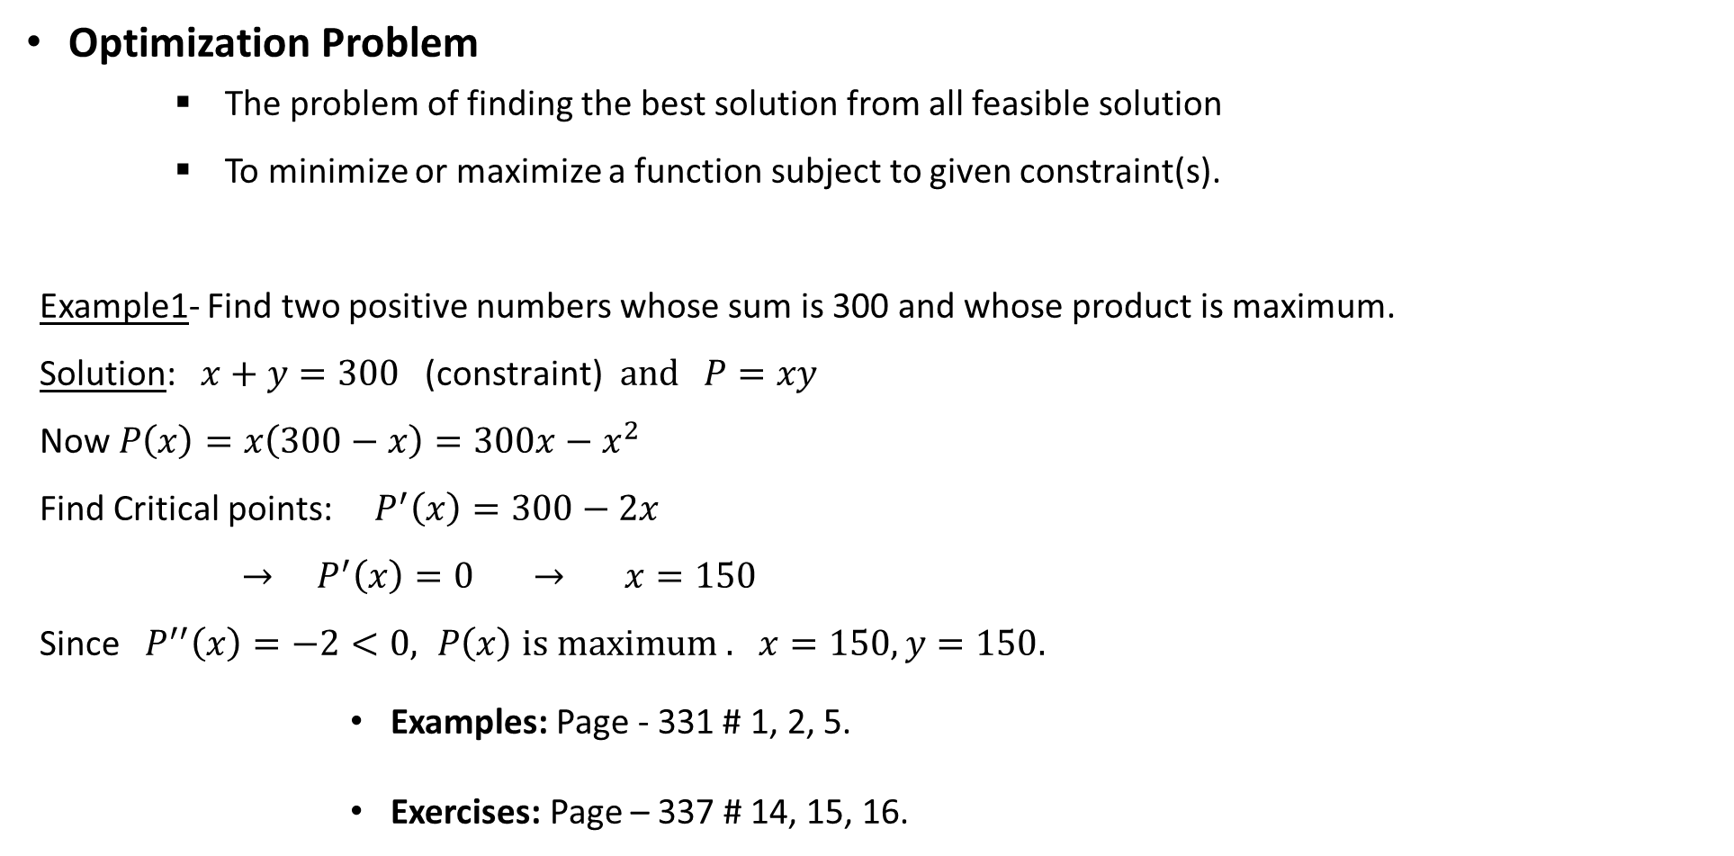
Optimization Problem
The problem of finding the best solution from all feasible solution
To minimize or maximize a function subject to given constraint(s).
Example1- Find two positive numbers whose sum is 300 and whose product is maximum.
Solution: $x+y=300 \text{(}\text{constraint}\text{)} and P=xy$
Now $P\left(x\right)=x\left(300−x\right)=300x−x^{2}$
Find Critical points: $P^{′}\left(x\right)=300−2x$
$→ P^{′}\left(x\right)=0 → x=150$
Since $P^{′′}\left(x\right)=−2<0, P\left(x\right)$ $is maximum .$ $x=150, y=150.$
Examples: Page - 331 # 1, 2, 5.
Exercises: Page – 337 # 14, 15, 16.

Slide 8
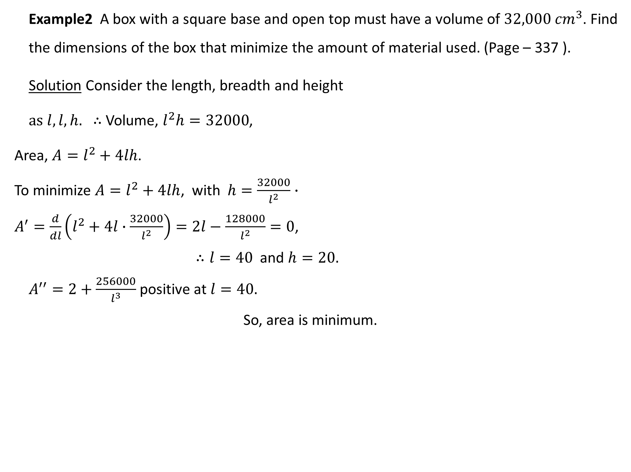
Example2 A box with a square base and open top must have a volume of $32,000 {cm}^{3}$. Find the dimensions of the box that minimize the amount of material used. (Page – 337 ).
Solution Consider the length, breadth and height
as $l,l, h.$ $∴$ Volume, $l^{2}h=32000$,
Area, $A=l^{2}+4lh$.
To minimize ${A=l}^{2}+4lh$, with $h=\frac{32000}{l^{2}}∙$
$A^{′}=\frac{d}{dl}\left(l^{2}+4l∙\frac{32000}{l^{2}}\right)=2l−\frac{128000}{l^{2}}=0$,
$∴l=40$ and $h=20.$
$A^{′′}=2+\frac{256000}{l^{3}}$ positive at $l=40.$
So, area is minimum.

Slide 9
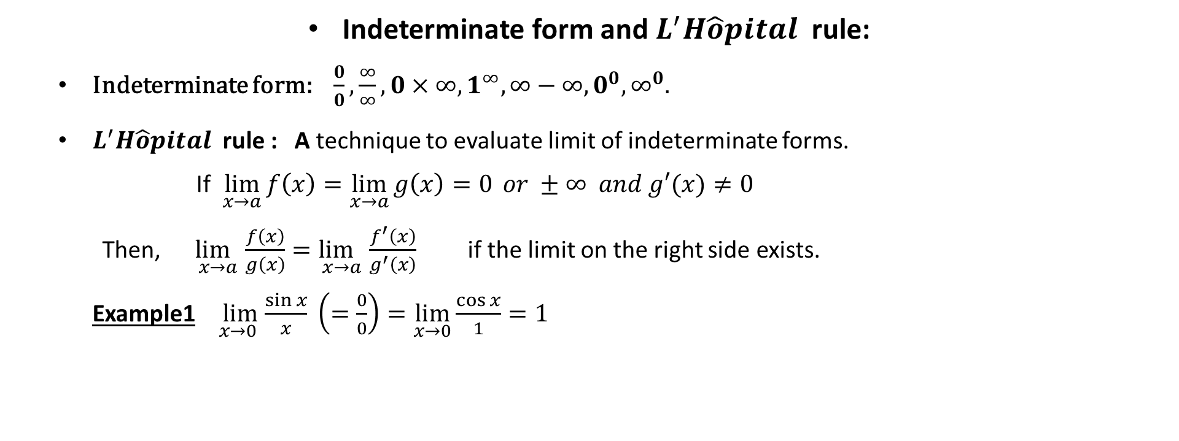
Indeterminate form and $L^{′}H\hat{o}pital$ rule:
Indeterminate form: $\frac{0}{0},\frac{∞}{∞}, 0×∞, 1^{∞}, ∞−∞, 0^{0}, ∞^{0}.$
$L^{′}H\hat{o}pital$ rule : A technique to evaluate limit of indeterminate forms.
If $\lim_{x→a}{f\left(x\right)=\lim_{x→a}{g\left(x\right)=0} or ±∞ and g′(x)≠0}$
Then, $\lim_{x→a}{\frac{f\left(x\right)}{g\left(x\right)}=\lim_{x→a}{\frac{f^{′}\left(x\right)}{g^{′}\left(x\right)}}}$ if the limit on the right side exists.
Example1 $\lim_{x→0 }{\frac{\sin{x}}{x} \left(=\frac{0}{0}\right)=\lim_{x→0}{\frac{\cos{x}}{1}=1}}$

Slide 10
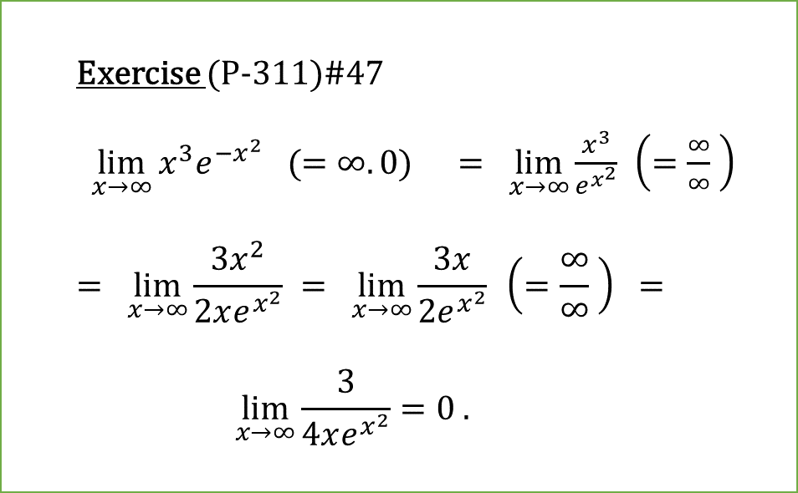

Example2 $\lim_{x→0^{+}}{x^{x}\left(0^{0}\right)=\lim_{x→0^{+}}{e^{ln(x^{x})}={e }^{\lim_{x→0^{+}}({xlnx)}}}}$
Now, $\lim_{x→0^{+}}\left(xln x\right)=\lim_{x→0^{+}}{\frac{\ln{x}}{\frac{1}{x}}\left(=\frac{∞}{∞}\right)=}$
$$\lim_{x→0^{+}}{\frac{\frac{1}{x}}{− \frac{1}{x^{2}}}=\lim_{x→0}{(−x)}=0}$$
$\lim_{x→0^{+}}\left(x^{x}\right)=\lim_{x→0^{+}}{e^{0}}=1$
Examples: Page - 306 # 1 - 4, 6, 7, 9, 10.
Exercise (P-311)#47
$\lim_{x→∞}{x^{3}e^{−x^{2}} (=∞.0)}$ $= \lim_{x→∞}{\frac{x^{3}}{e^{x^{2}}}}$ $\left(=\frac{∞}{∞} \right)$
$$= \lim_{x→∞}{\frac{3x^{2}}{2xe^{x^{2}}}} = \lim_{x→∞}{\frac{3x}{2e^{x^{2}}}} \left(=\frac{∞}{∞} \right) =$$
$$\lim_{x→∞}{\frac{3}{4xe^{x^{2}}}=0 . }$$

Slide 11


Exercise (P-311)#51
$\lim_{x→1}\left(\frac{x}{x−1}−\frac{1}{\ln{x}}\right) \left(=∞−∞\right)=$
$\lim_{x→1}\left(\frac{x\ln{x} − x + 1}{\left(x−1\right)ln{x}}\right)$ $\left(=\frac{0}{0}\right)=$
$=\lim_{x→1}\left(\frac{x \frac{1}{x} + \ln{x}−1}{\left(x−1\right)\frac{1}{x} + ln{x}}\right)$ $\left(=\frac{0}{0} \right)$ $=\lim_{x→1}\left(\frac{\ln{x}}{1− \frac{1}{x} + ln{x}}\right)$ $\left(=\frac{0}{0} \right)$
$=\lim_{x→1}\left(\frac{\frac{1}{x}}{\frac{1}{x^{2}} +{\frac{1}{x}}}\right)$ $=\frac{1}{2}$
Exercises: Page – 311 # 13, 15, 19, 43, 47, 51, 53, 57, 63, 65.
Exercise (P-312)#63
$\lim_{x→∞}{x^{\frac{1}{x}}=}\lim_{x→∞}{e^{\ln{(x^{\frac{1}{x}})}}=}\lim_{x→∞}{e^{\frac{1}{x}\ln{(x)}}=}{e^{\lim_{x→∞} \frac{1}{x}\ln{(x)}}=}$
Now, $\lim_{x→∞}{\frac{1}{x}\ln{x}=}\left(\frac{∞}{∞}\right)=\lim_{x→∞}{\frac{\ln{x}}{x}=}$
$\lim_{x→∞}{\frac{\frac{1}{x}}{1}=}$ $\lim_{x→∞}{\frac{1}{x}=0}$
$$\lim_{x→∞}{x^{\frac{1}{x}}=}e^{0}=1$$

Slide 12
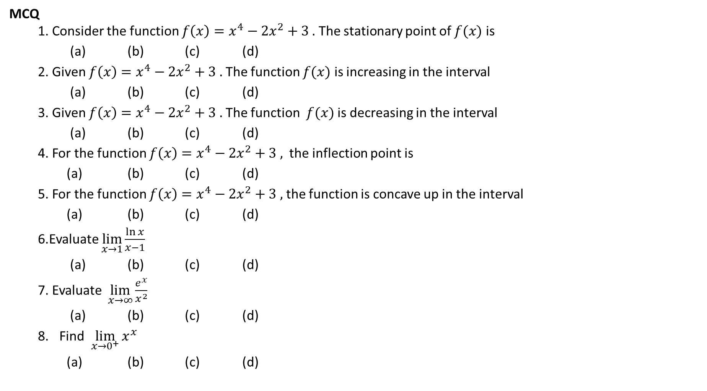
MCQ
1. Consider the function $f\left(x\right)=x^{4}−2x^{2}+3 .$ The stationary point of $f(x)$ is
(a) (b) (c) (d)
2. Given $f\left(x\right)=x^{4}−2x^{2}+3 .$ The function $f(x)$ is increasing in the interval
(a) (b) (c) (d)
3. Given $f\left(x\right)=x^{4}−2x^{2}+3 .$ The function $f(x)$ is decreasing in the interval
(a) (b) (c) (d)
4. For the function $f\left(x\right)=x^{4}−2x^{2}+3 ,$ the inflection point is
(a) (b) (c) (d)
5. For the function $f\left(x\right)=x^{4}−2x^{2}+3 ,$ the function is concave up in the interval
(a) (b) (c) (d)
6.Evaluate $\lim_{x→1}{\frac{\ln{x}}{x−1}}$
(a) (b) (c) (d)
7. Evaluate $\lim_{x→∞}{\frac{e^{x}}{x^{2}}}$
(a) (b) (c) (d)
Find $\lim_{x→0^{+}}{x^{x}}$
(a) (b) (c) (d)

Slide 13

$$\lim_{x→∞}{x^{\frac{1}{x}}}$$

